Slide 1

Student
Photo
Complete the fields
Candidate name: ___________________________
Restorative Case: _ of 6 Date: __/__/____

Slide 2
CGDent Clinical and Technical Domain Case Report
State here what discipline within Restorative Dentistry the case covers (delete as appropriate):
Endodontics
Periodontics
Prosthodontics

Slide 3
Patient details
* Candidates may use patient’s initials
But patient’s name must NEVER appear anywhere in case report
(including chart, radiographs, referral letters etc)
*
Patient code Male/Female | 666
Date of birth
Occupation
Relevant medical history
Consent | Mark With x
Consent for treatment signed
Permission to use case for CGDent assessment
Photographic consent form signed
Mandatory
All clinical cases
Candidates must keep signed consent forms
with patient’s records
Examiners may request documents

Slide 4
History
Reason for attendance (RFA)
Patient complains of (PCO)
Last dental treatment (LDT) /examination
e.g. Routine examination
List patient complaints
in order of severity
Months /Years
Pre-operative occlusal views
Upper & lower
Mandatory
For all clinical cases
& mirror images must be
flipped horizontally

Slide 5
Examination – key headings
Extra-oral examination
Soft Tissue Examination
Dental Charting
Periodontium
Restorations
Caries
Tooth wear
Occlusion
Endodontic assessment where relevant
Aesthetic evaluation where relevant
Assessment of edentulous areas where relevant
Submission of a pre-operative chart is mandatory for all clinical cases
Important: Where digital charts are submitted students must ensure that the patient’s name is removed/blanked out

Slide 6
Extra-Oral and Soft Tissue Examination
Record all relevant examination findings related to
Extra-Oral and Soft Tissue Examination
ie only record abnormal or potentially abnormal findings
Supportive (annotated) clinical images may
be included where relevant

Slide 7
Dental Charting
Submission of a pre-operative chart is mandatory for all clinical cases
Important: Where digital charts are submitted students must ensure that the patient’s name is removed/blanked out

Slide 8
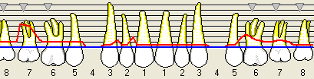
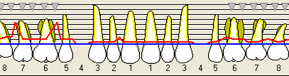
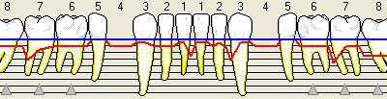
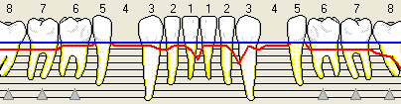
Periodontal assessment – BSP criteria*
Post-operative review 6PPC may be inserted along side pre-operative 6PPC for comparison
Risk factors
Record relevant findings
BPE
6PPC
Periodontitis risk category
*
e.g. Smoker (type/quantity/history)
Diabetes, family history
Mandatory All clinical cases
Upper buccal (Pre-op)
1 | 1 | 1
1 | 2 | 1
Upper palatal (Pre-op)
Where relevant
Lower buccal (Pre-op)
High
Medium
Low
Upper lingual (Pre-op)
*https://www.bsperio.org.uk/assets/downloads/BSP_BPE_Guidelines_2019.pdf

Slide 9
Caries Assessment
Caries Lesions identified
Assessment of diet
Oral hygiene analysis
Caries risk/susceptibility assessment
Identify all teeth which have caries
Supportive (annotated) clinical images or other documents may
be included where relevant
e.g. 4 - 5 Cans Coke every day
Sweets every day
Sucks mints & boiled sweets
e.g. Brushing morning only
Fluoride toothpaste (1500ppm)
No interdental aids
High
Medium
Low

Slide 10
Assessment of Restorations
Indicate Restorations which are defective or have compromised marginal integrity
Justification must be provided when restoration replacement is planned
Supportive (annotated) clinical images may
be included where relevant

Slide 11
Toothwear
Document pathological and/or severe tooth wear if present
Present a risk assessment if pathological and/or severe tooth wear is present

Slide 12
Occlusion
Document static and dynamic tooth contacts
Indicate any occlusal interferences if present
Record any occlusal factors relevant to the outcome or management of your case

Slide 13
Special tests (Radiography)
Radiographic report
Mandatory for all submitted radiographs
Type
Digital/conventional
View(s)
Grade
1/2/3
Diagnostic findings
Grade 2
Grade 1
e.g. Right & left
horizontal bitewings
1 | Excellent | No errors
2 | Diagnostically acceptable | Some errors but nothing that detracts from the diagnostic utility of the radiograph
3 | Unacceptable | Errors which render the radiograph diagnostically unusable
Concise report of relevant
findings for each radiograph

Slide 14
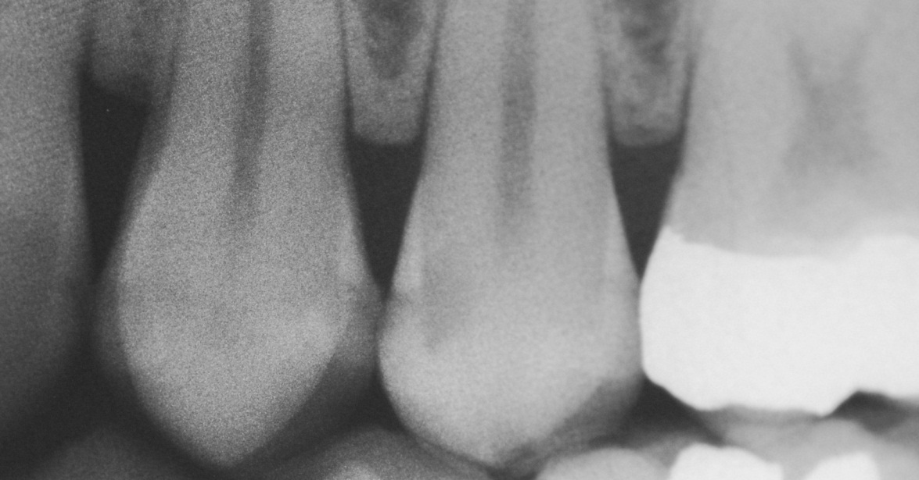
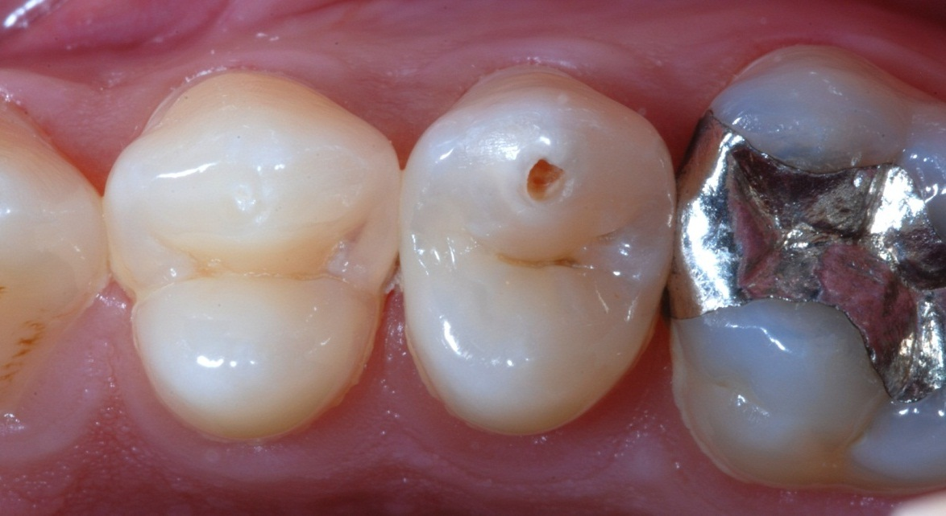
Radiography (Recording carious lesions)
Diagnostic features
May be highlighted on cropped radiographs to support diagnosis
Radiographs may
Be cropped and presented with pre-op images of the area of main complaint
?
D2
Presentation tip
Use lines drawn in powerpoint to help line up & size images
Erase these before submission

Slide 15
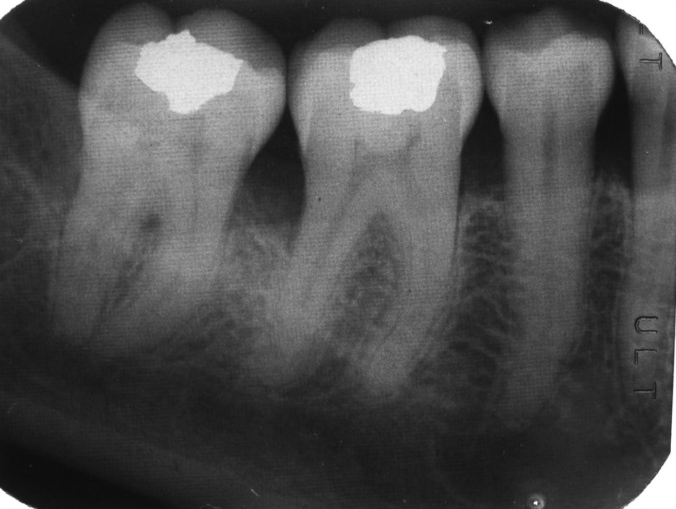
Periodontal radiography
Radiographs (or clinical images) demonstrating periodontal may also be presented where relevant
All radiographic images must be justifiable
NB: Different patient not relevant to this example
Poorly defined alveolar crest
Don’t record negative findings
20%
Horizontal
bone loss
Lamina dura
intact
Loss of lamina dura

Slide 16
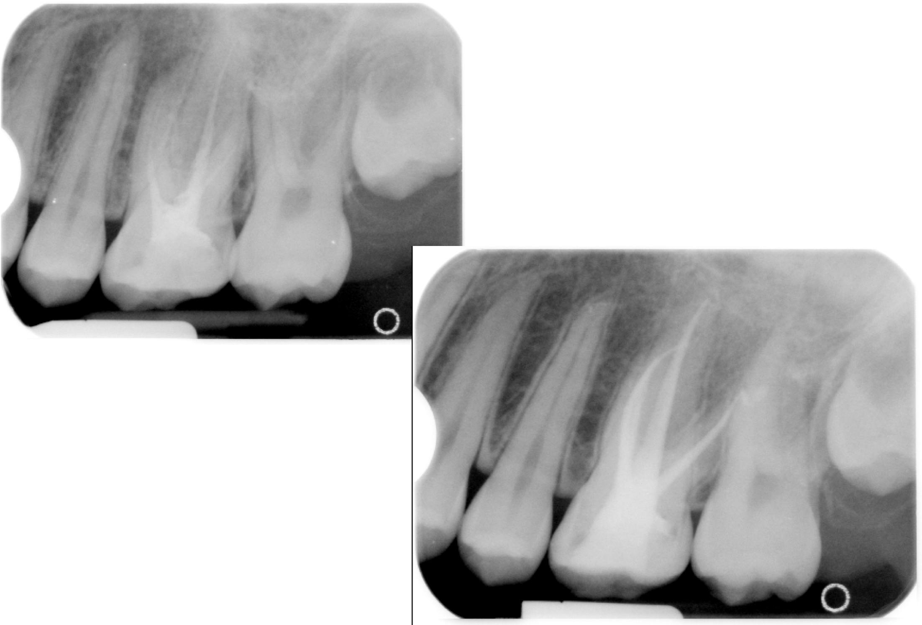
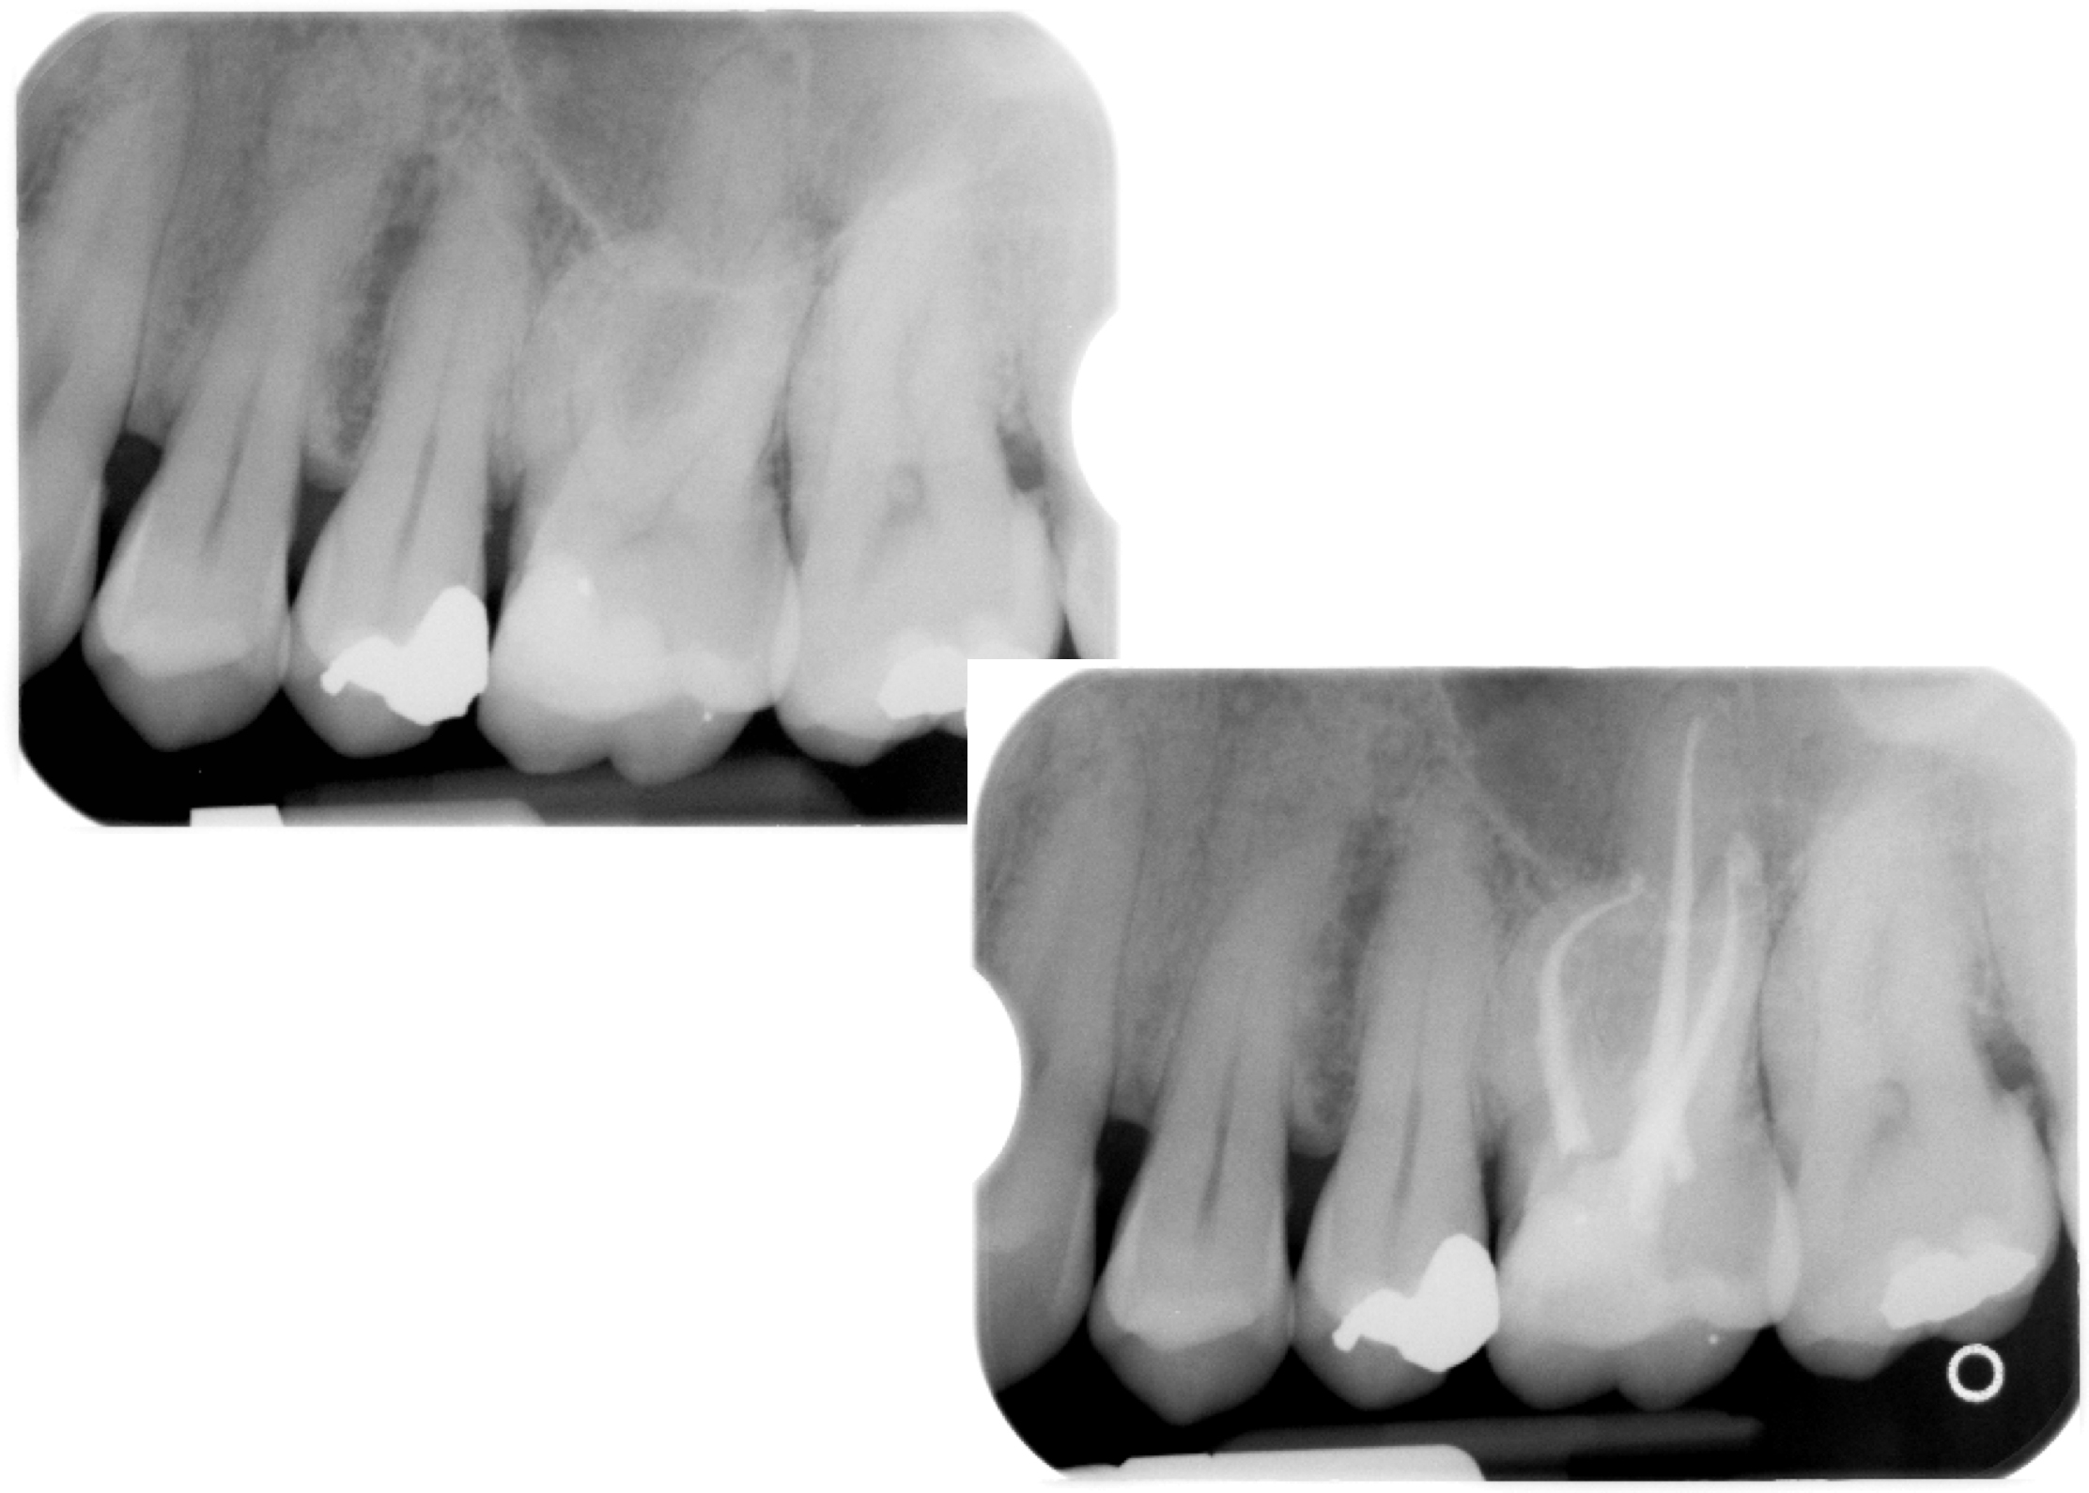
Endodontic radiography
Poorly defined alveolar crest
Radiograph/s to show pre-op periapical view of the tooth being treated is mandatory. Radiographs taken during the treatment can be presented. A post op view of the final obturation achieved is mandatory
All radiographic images must be justifiable

Slide 17
Special tests (Endodontic health)
Sensibility testing where relevant
Only where clinically indicated for diagnosis/monitoring
Record positive/negative
Use control teeth
Indicate the test undertaken eg endo ice/frost

Slide 18
Area of focus for case report / area of main complaint
Presentation tip
When taking clinical photographs think about how you will present them on a powerpoint slide
See next slide

Slide 19
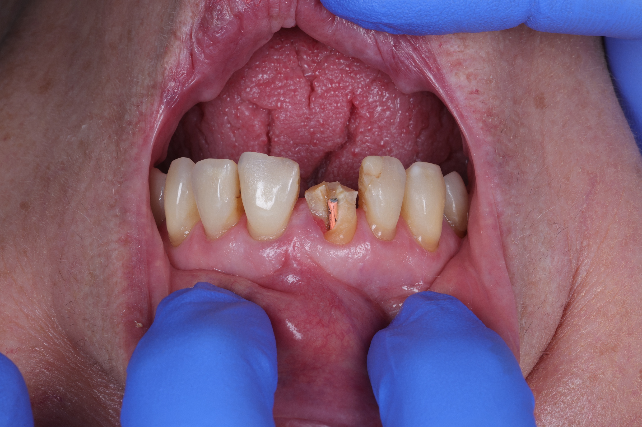
Area of focus for case report / area of main complaint
Close-up pre-operative image (rotated/cropped) to demonstrate subject of case report
Provide a caption to describe what the image is depicting eg: patient presents with a fractured upper right central incisor.

Slide 20
Diagnosis
Provide a clear diagnosis/differential diagnosis for your case. Indicate any further tests which are required.

Slide 21
Management options
Give a list of the options relevant to your case.

Slide 22
Personalised care plan
Provide a numbered list of all treatment/management items in the order that you are expecting to carry them out with justifications as to why, including non-operative measures / active surveillance

Slide 23
Justification for chosen care plan
Demonstration of the evidence base to support your care plan must be provided with respect to:
Justification for operative treatment(s)
Advantages of this option over others
Risk/benefit analysis
Evidence of valid consent*
Medico-legal considerations
Shared decision-making
Referral for specialist care/opinion.
*including consent for use of data –see template patient information sheet and consent form.

Slide 24
Description of treatment
Provide a concise (illustrated where appropriate) description of treatment/management carried out.
Appropriate clinical images demonstrating clinical stages may be submitted to support text (& aid concision)

Slide 25
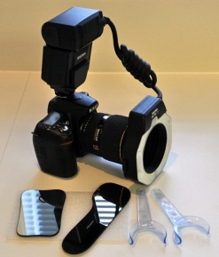
Outcome
Candidate must describe their opinion of the outcome of the care plan with regard to:
Patient experience
Oral health benefit/gain
Aesthetic quality (where relevant)
Prognosis
Long-term maintenance strategy (patient & operator)
Recall frequency
Estimated longevity
Estimated mode of failure
How will failure be managed?
Post-op close-up occlusal image
Mandatory view
Highlight the features relevant to your case and to demonstrate that the desired outcome has been achieved.

Slide 26
References
List the references relevant to your case indicating an evidence based approach to your treatment and management.

Slide 27
Reflection (Word limit maximum = 1000)
Candidates must demonstrate insight into the positive & negative learning outcomes of the case. This may be submitted as a separate document.
Subject areas for discussion may include:
Describe how patient & operator benefitted from this case
How do successful aspects relate to assessment, planning, techniques, equipment and materials?
Identify challenges, difficulties, compromises (how were they managed?)
What would you do differently in future?
Identify how errors will inform future procedures
Describe what you have learned from the use of clinical photography
Describe any learning outcomes regarding photographic technique
Describe how you are going to integrate learning outcomes from this case into everyday practice.

Slide 28
Presentation quality – guide to assessment
Text
Scientific writing style
Precise dental terminology
Reflection within word limit
Spelling/grammatical errors
Evidence base to support case
References
Clinical photography
Appropriate supportive views
Quality 1/2/3
Positioning
Focus
Exposure
Technique errors

